Slide 1

Webinar for Federal Oversight Personnel
November 13, 2024
Status of DOELAP Standards
David L. Pugh, CHP, RRPT
Office of Worker Safety and Health Policy (EHSS-11) Office of Environment, Health, Safety and Security
U.S. Department of Energy

Slide 2
Status of DOELAP Standards
DOE-STD-1095-20XX, DOELAP for Personnel Dosimetry
  Final concurrence ended on Friday, 11/8
  Expected to be finalized this month
DOE-STD-1111-20XX, DOELAP Administration
  Response and negotiation phase closed on November 4th
  Expected to be finalized in January
DOE-STD-1112-2019, DOELAP for Radiobioassay
  Drafting will begin in Spring 2025

Slide 3
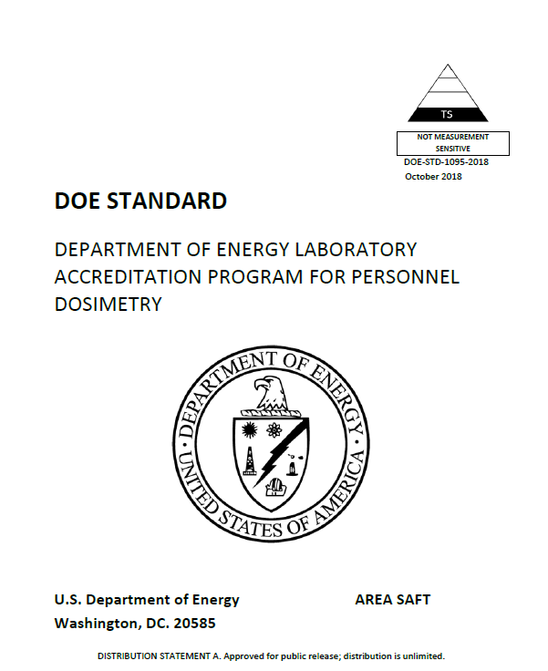
DOE-STD-1095 Revision
Revision to the Personnel Dosimetry standard includes:
  Continuity of Accredited Activities
  Clarification of blind testing program requirements
  Example management review template added to Appendix

Slide 4
DOE-STD-1095 Revision
Revision to the Personnel Dosimetry standard includes:
  Continuity of Accredited Activities
  Clarification of blind testing program requirements
  Example Management Review Template added to Appendix

Slide 5
Defense Nuclear Facility Safety Board Staff Letter to Secretary Granholm
DOE-STD-1095-2018 “contains a weakness…”
Compliance requires “documented provisions to utilize the services of another DOELAP accredited laboratory in an emergency”
  No requirement to periodically exercise provisions
“If site tested and demonstrated its emergency backup plan…, it could have identified the weakness”

Slide 6
DOE Response to Defense Nuclear Facility Safety Board
Office of Environment, Health, Safety and Security committed to revise DOE-STD-1095:
  Clarify several provisions of the Standard, including continuity of operations
  Modify assessor training for both personnel dosimetry and radiobioassay programs to increase focus on the review continuity of operations plans

Slide 7
DOE-STD-1095, Personnel Dosimetry: Continuation of Accredited Activities
Documented plan to ensure continuation of accredited activities in the event of a temporary and unexpected loss of capability, up to 6 months
  Duplicate measurement systems
  Backup service provider
Duplicate measurement systems and backup service provider capabilities shall be exercised
Plan shall also identify key personnel and document methods for mitigation of the loss of personnel until qualified replacements are in place

Slide 8
DOE-STD-1112 Revision, DOELAP for Radiobioassay
Drafting scheduled for Spring 2025
Like 1095, continuity of accredited activities will be addressed
Clarification of blind audits and other testing requirements under quality improvement
Supplementary information on MDA and Lc may be included in the appendix
Administrative updates

Slide 9
DOE-STD-1111 Revision, DOELAP Administration
Expected to be finalized in January 2025
Revision clarifies assessment findings
Expands the scope of an amendment beyond the text in the current version
Appendix B was updated to reflect the membership and current practice of the Oversight Board
Appendix C, ‘DOELAP Exceptions,’ revised so text pertains to both personnel dosimetry and radiobioassay programs
Notes:
The proposed draft for this standard includes minor changes throughout the body of the document to add clarification where needed. The revised document also contains changes that are more substantive in nature. Specifically, the draft clarifies assessment findings (section 4.4) and expands the scope of an amendment beyond the text in the current version (section 5.5). Appendix B was updated to reflect the membership and current practice of the OSB, and Appendix C, ‘DOELAP Exceptions,’ was revised so that the language pertains to both personnel dosimetry and radiobioassay programs.

Slide 10

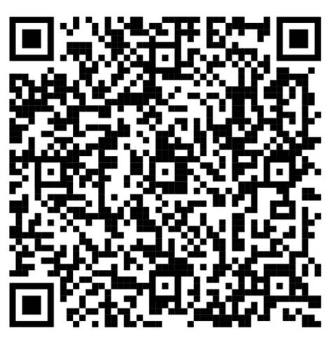
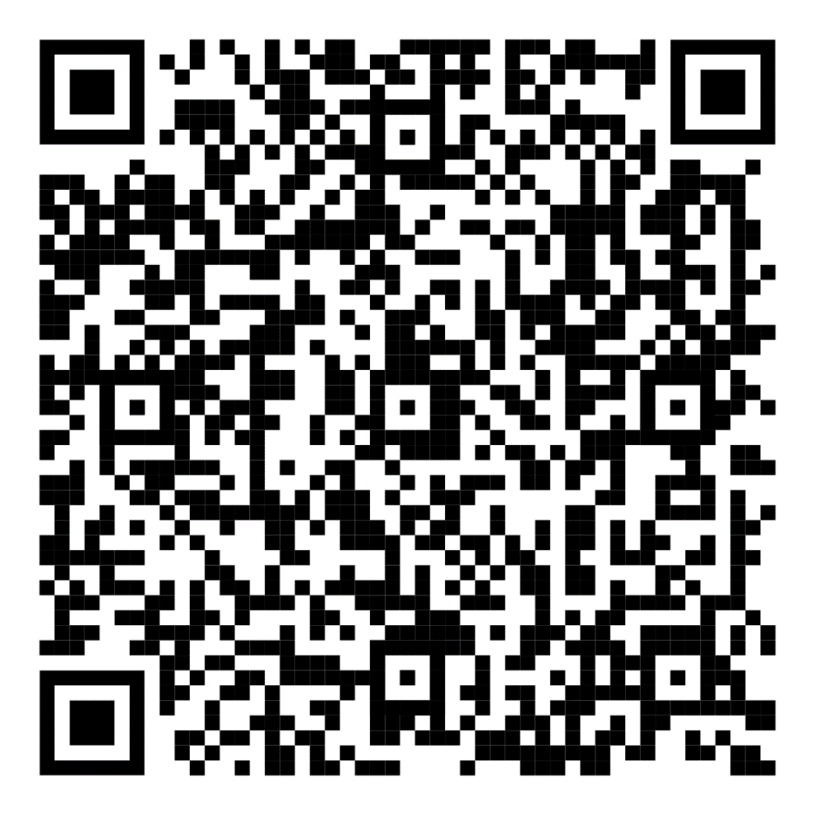
EHSS-11 PC Portal
Have a question regarding worker safety and health policy?
Submit your questions to the EHSS-11 PC Portal
https://pcportal.doe.gov

Slide 11
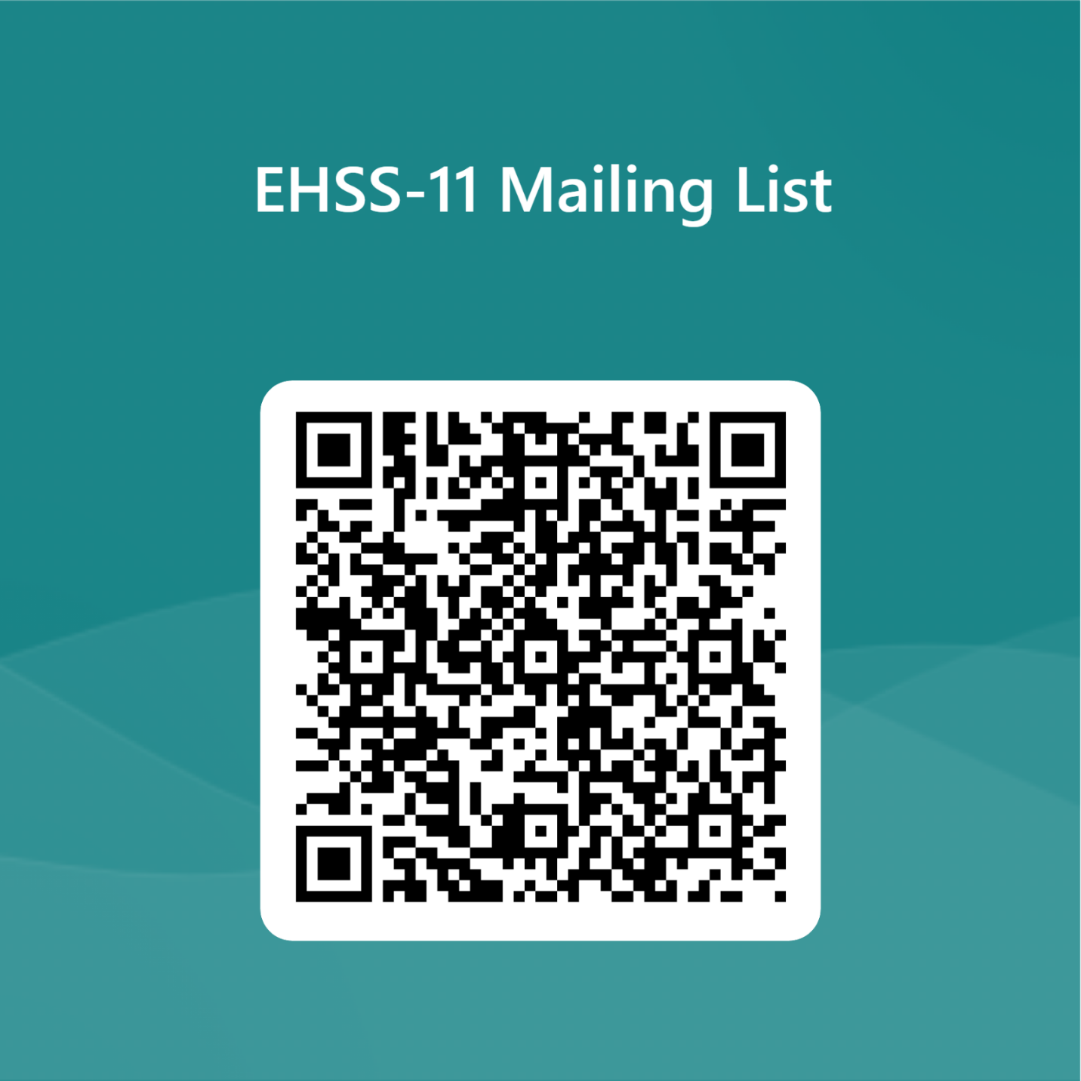
Join our EHSS-11 mailing list
WebEx invitations
Policy Clarifications
Standard/Directive Developments
Rulemaking news
Worker Safety and Health Event Notifications

Slide 12
Contact Information
David L. Pugh, CHP, RRPT
Office of Worker Safety and Health Policy
301-903-7339
david.pugh1@hq.doe.gov

